Slide 1
5CS024 – 7CC002 Products & Process

Slide 2
Agile
Design
Thinking
Kanban
Scrum
Lean
Notes:
Practices and Methods

Slide 3
History of Software Development Processes
The process of creating some software:
Ad hoc (Primal, hacking)
Waterfall (Classical)
Iterative (Evolutionary, Agile)

Slide 4
Ad hoc
Latin phrase meaning "for this purpose".
The “as and when” approach
The Ad Hoc project typically contains:
Minimal formal organisation
Scope may change
Records and decision making

Slide 5
Ad hoc
Advantages
Fast
Flexible
Disadvantages
Often chaotic
Often re invents the wheel
Little or no quality assurance
Frowned upon for almost all serious projects

Slide 6
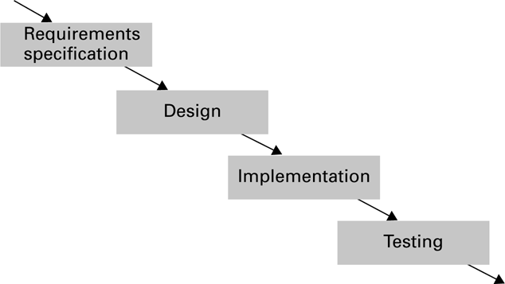
Waterfall

Slide 7
Waterfall
The classical model
Discrete clearly specified stages
Advantages
Clear stages and deliverables
Disadvantages
Hard to go back a stage

Slide 8
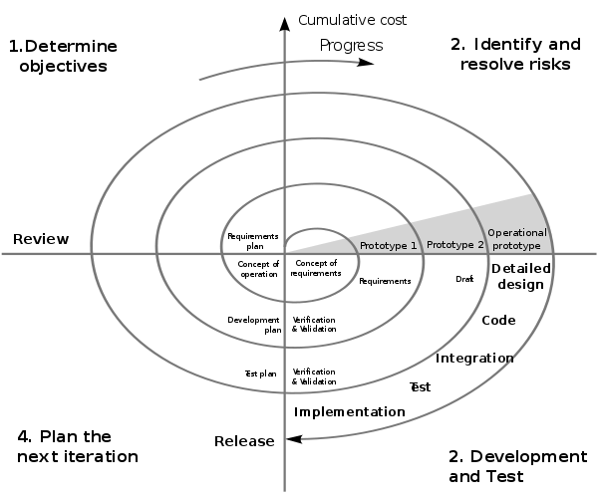
Iterative

Slide 9
Iterative
Prototyping (Early development)
Multiple versions produced
Advantages
Start getting feedback early
Disadvantages
Time and resources

Slide 10
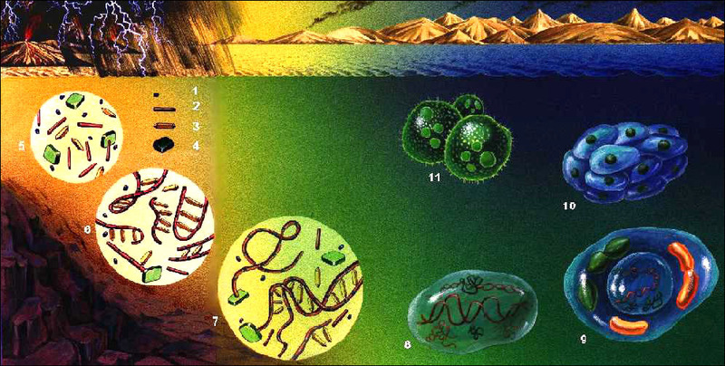
Primordial Soup of Agile development
Popularity of:
Open Source Movement
Object Oriented Paradigm
Prevalence of:
Internet & World Wide Web
Distributed Systems
Late 90’s Dot Com Boom
Race to market
Small teams, big tasks

Slide 11
Where does Agile Development begin?
Agile Development Manifesto (2001)
https://agilemanifesto.org/

Slide 12
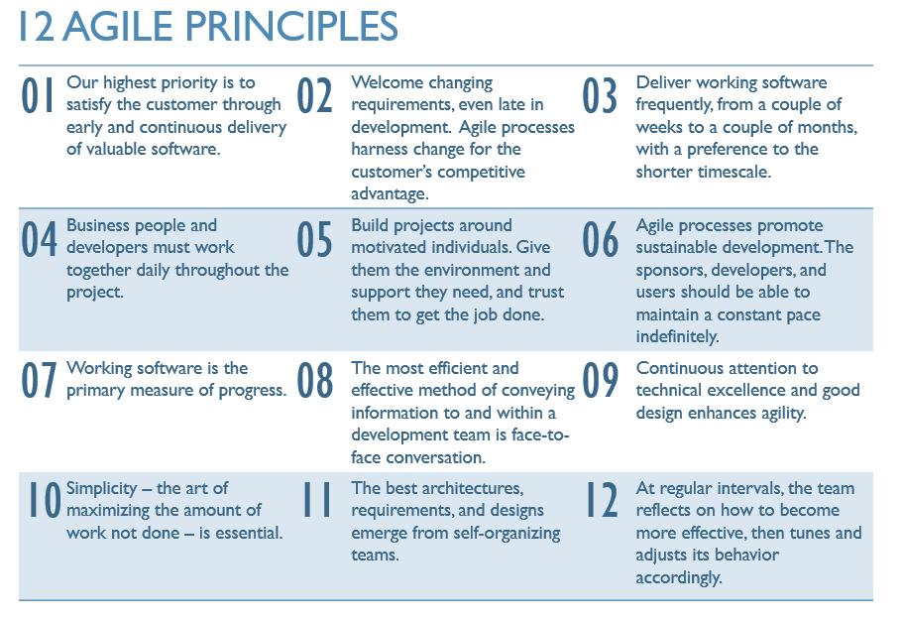

Slide 13
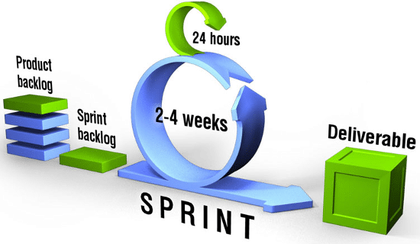
Scrum

Slide 14
KANBAN
TO DO
Doing
Done

Slide 15



Tools (Fundamental)

Slide 16
Innovation Funnel
Ideas
Features and ideas for work based on previous modelling
Validation
Filter and prioritise ideas, decide which features to make
Create
Features currently being coded and tested
Deliver
Working features (Cumulative)
Idea
Validation
Create
Deliver

Slide 17





Incremental Development
Incremental Development
Information Feedback Loops
Developers –-- Stakeholders/Customers
Repeat Process - Refine Output
Working systems are ‘Evolved’

Slide 18
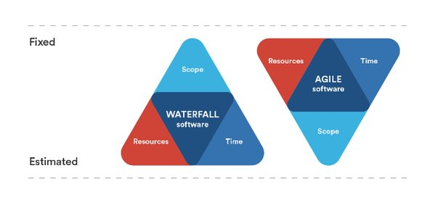
The iron triangle of project management

Slide 19
Questions

